Slide 1
Louisville Weather &
Business Risk Monitor
End-to-End Data Engineering Pipeline & Interactive Analytics Dashboard
Oluwatosin Adelusi • Louisville, KY
Python • Open-Meteo API • Supabase PostgreSQL • Plotly Dash
Data Engineering Capstone • Week 5 Presentation

Slide 2
The Business Problem
Louisville businesses need proactive weather risk intelligence — not reactive damage control
No proactive visibility
Logistics disruptions
Businesses currently have no automated way to see how upcoming weather will impact operations across 5 key sectors.
High-wind or heavy-rain days cause delivery delays, route failures, and staffing shortfalls — often discovered too late.
Energy demand spikes
No consolidated risk view
Utility operators lack advance notice of HDD/CDD spikes, making grid balancing and demand planning reactive rather than proactive.
No single dashboard covers Utilities, Retail, Logistics, Tourism, and Insurance simultaneously against a 16-day forecast window.
This project delivers an automated 16-day early-warning system: proactive risk assessments for 5 business sectors — before events happen.
Louisville Weather & Business Risk Monitor · Oluwatosin Adelusi

Slide 3
Data Source & System Architecture
One API · one pipeline script · one dashboard
Open-Meteo
API
ETL_script.py
Supabase
PostgreSQL
dash_app.py
Dash
Free · No key
Louisville, KY
→
Extract →
Transform →
Validate → Load
→
7 tables
3NF schema
Bulk insert
→
5 KPI cards
5 charts
3 filters
API Variables Fetched
Reference CSV Files
temperature_2m_max / min / mean (°F)
weather_code.csv
— 21 WMO code descriptions
precipitation_sum (inches)
location.csv
— Louisville coordinates
wind_speed_max (mph) · humidity_2m (%)
sector.csv
— 5 business sector definitions
weather_code (WMO) · uv_index · sunrise/sunset
sector_weather_sensitivity.csv
— per-sector risk rules
Louisville Weather & Business Risk Monitor · Oluwatosin Adelusi

Slide 4
ETL Pipeline — 9 Stages
Extract · Validate · Clean · Enrich · Validate · Aggregate · Load CSV · Load DB · Verify
1
2
3
4
5
6
7
8
9
Extract
Validate Raw
Clean
Enrich
Validate Clean
Aggregate
Load CSV
Load DB
Verify
→
→
→
→
→
→
→
→
Open-Meteo
API call
4 API checks
Normalise
& coerce
WMO code
join
6 quality
checks
Weekly
summary
Incremental
upsert
Supabase
bulk insert
Row count
check
Outputs:
daily_weather_forecast.csv
weekly_weather_summary.csv
Supabase — 7 tables loaded
Dash app — localhost:8050
incremental append
3-week aggregation
bulk insert per run
live DB queries
Louisville Weather & Business Risk Monitor · Oluwatosin Adelusi

Slide 5
Database Schema — 3NF PostgreSQL
7 tables · normalised to Third Normal Form · hosted on Supabase
location
weather_code
sector
PK: location_id
PK: weather_code_id
PK: sector_id
1 row
Louisville, KY
21 rows
WMO descriptions
5 rows
business sectors
weather_observation
risk_metric
sector_weather_sensitivity
PK: observation_id
PK: risk_id
PK: sensitivity_id
16 rows
daily forecast data
16 rows
HDD/CDD + flags
15 rows
per-sector rules
sector_daily_impact · PK: impact_id · FK: observation_id + sector_id · 80 rows (16 days × 5 sectors) · impact_level: low / moderate / high / severe
Louisville Weather & Business Risk Monitor · Oluwatosin Adelusi

Slide 6
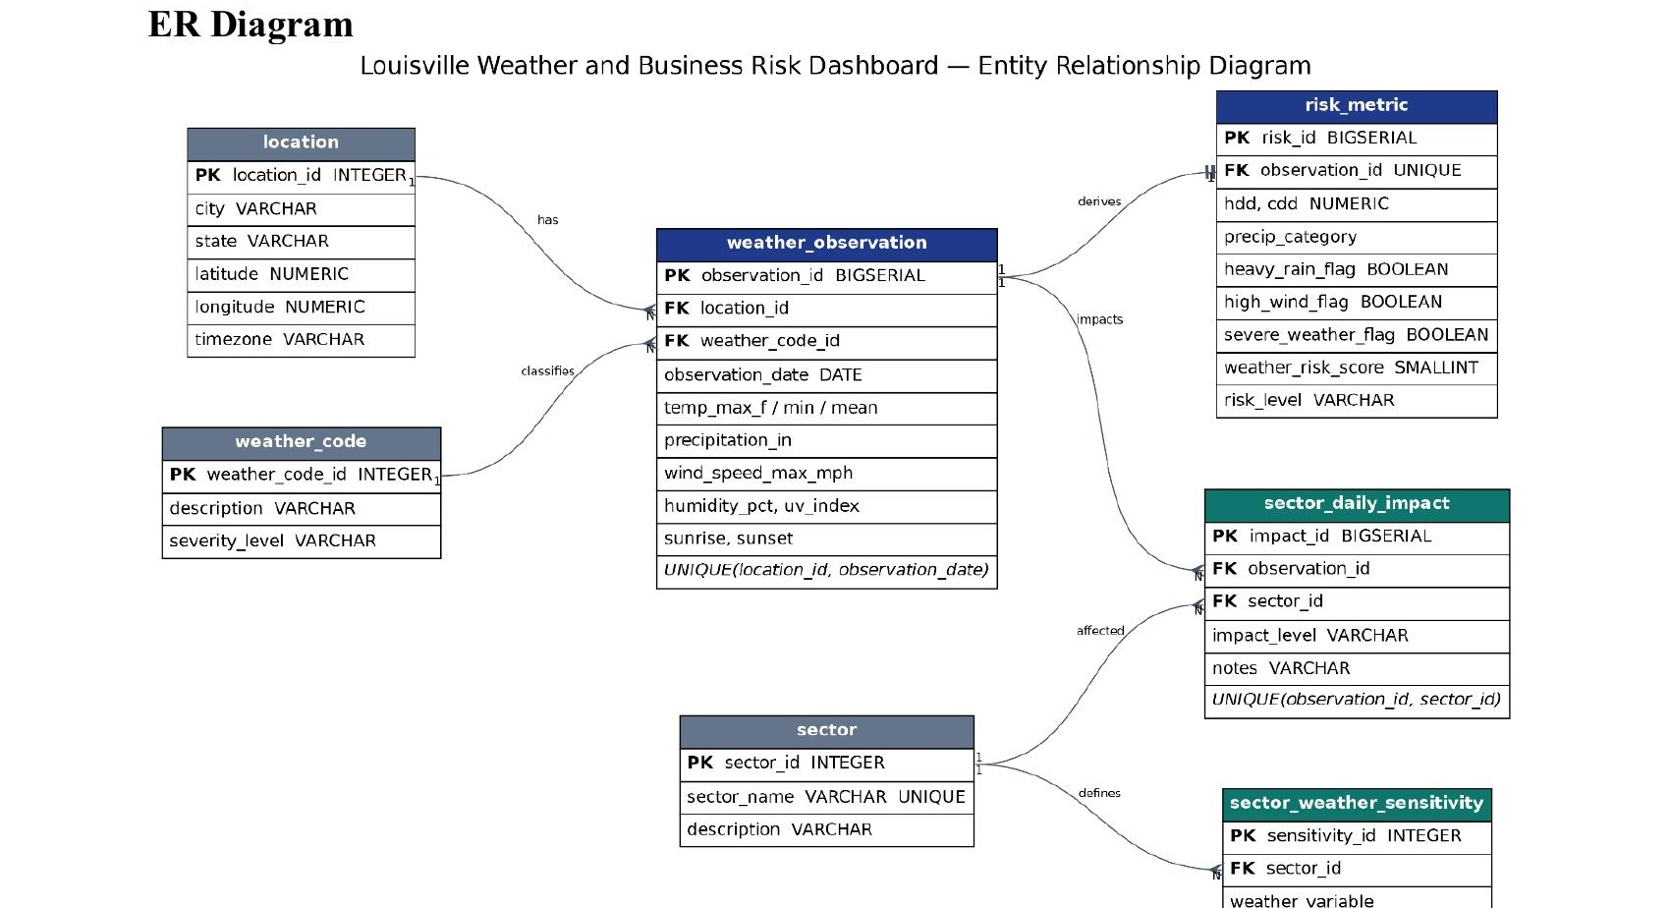
Entity Relationship Diagram
All 7 tables · Primary keys · Foreign key relationships · Cardinality
Louisville Weather & Business Risk Monitor · Oluwatosin Adelusi

Slide 7
ETL & Validation Approach
3 rounds of validation — raw API · clean data · post-load verification
01 Raw Response Validation
02 Clean Data Validation
03 Post-Load Verification
✓ API response must be a dictionary
✓ All required columns present
✓ Row count match for all 7 tables
✓ Daily data key present
✓ No nulls in critical fields
✓ Expected vs actual reconciliation
✓ All required fields exist
✓ temp_max ≥ temp_min (business rule)
✓ PASS / MISMATCH logged per table
✓ At least 1 forecast day returned
✓ Temperatures within −60°F to 130°F
✓ Pipeline fails loudly — never silently
✓ No negative precipitation
✓ No duplicate date keys
Louisville Weather & Business Risk Monitor · Oluwatosin Adelusi

Slide 8
Dashboard Demo — Plotly Dash
5 KPI cards · 5 interactive charts · 3 dynamic filters · live Supabase queries
5
5
3
80
16
KPI Cards
Interactive Charts
Dynamic Filters
DB rows queried
Forecast days
Temperature Trend
Precipitation
Max / Mean / Min — 16-day line chart
Daily rainfall by category (bar chart)
Risk Score Chart
Wind & Humidity
Bar chart colour-coded calm → severe
Dual-axis: wind mph + humidity %
Sector Heatmap
5 sectors × 16 days impact matrix
Filters: Date Range Picker · Sector Checklist · Risk Level Dropdown — all callbacks update every chart simultaneously
Louisville Weather & Business Risk Monitor · Oluwatosin Adelusi

Slide 9
Key Insights & Business Value
What does the 16-day forecast actually tell each sector?
Logistics
High-wind days flagged 16 days in advance
Days with wind > 25 mph or rain > 1 in trigger High impact. Dispatch teams pre-plan routing before the event.
Utilities
HDD/CDD spikes predict energy demand weeks out
Heating & Cooling Degree Days computed daily. Grid operators see demand ramps before they happen.
Tourism
Severe composite drives event risk alerts
When wind, rain, and temp extremes combine, Tourism registers Severe impact venue managers get early warning.
Retail
Heavy rain days linked to foot traffic drop
Precipitation > 1 inch triggers Moderate retail impact stores adjust staffing and promotions in advance.
Insurance
Claims risk visible on a 16-day horizon
Severe weather composite elevates Insurance to High impact adjusters pre-positioned before storms arrive.
Louisville Weather & Business Risk Monitor · Oluwatosin Adelusi

Slide 10
Challenges & How They Were Solved
✗
Getting data from the Open-Meteo API
✓
Parsed the free Open-Meteo REST API (no key required) using Python requests. Mapped daily parameters — temp, precipitation, wind, UV, WMO codes — into clean pandas DataFrames with consistent types and timestamps.
✗
Understanding and structuring the raw API response
✓
The API returns nested JSON (hourly vs. daily keys). Wrote a dedicated extraction function to flatten the daily block and align all 14 variables into a single row per forecast day before any transformation.
✗
Initially built the dashboard in Power BI
✓
The original proposal used Power BI Desktop connected to CSV files. This worked for static snapshots but required manual refresh, had no Python integration, and could not query a live PostgreSQL database.
✗
Power BI limitations led to the switch to Plotly Dash
✓
Power BI could not connect to Supabase PostgreSQL directly and lacked callback interactivity. Migrated to Plotly Dash — full Python control, live DB queries, and all 3 filters update 5 charts simultaneously via callbacks.
✗
Re-building all visualisations after the Power BI → Dash migration
✓
Every chart (temperature trend, precipitation bars, risk score, wind/humidity dual-axis, sector heatmap) was rebuilt in Plotly Express/Graph Objects. Dash delivered richer interactivity than Power BI with less manual effort.
Louisville Weather & Business Risk Monitor · Oluwatosin Adelusi

Slide 11
Oluwatosin Adelusi · Data Engineering Capstone · Week 5
Thank You
Open-Meteo API → ETL_script.py (Python) → Supabase PostgreSQL → Plotly Dash
7
9
16
5
80
DB Tables
ETL Stages
Forecast Days
Business Sectors
Risk Impact Rows

